Slide 1
Elemental SmashDown
Gray Bohnen

Slide 2
Gameplay
Each player has a hand of five monsters
Players spend their turns attacking the opponent’s monsters
Each turn, a random element is chosen that determines which stats monsters fight with
Players get points based on the difference between the fighting monsters stats
First player to 20 wins
Players can resurrect dead monsters once per turn

Slide 3

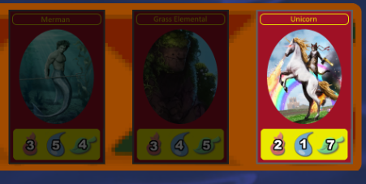
Movement/Performance
Movement:
Originally a bar that decreased each attack
Now cards are greyed out after attacking.
Performance
Originally a raw score number on screen
Developed into a segmented health bar
with text overlay

Slide 4
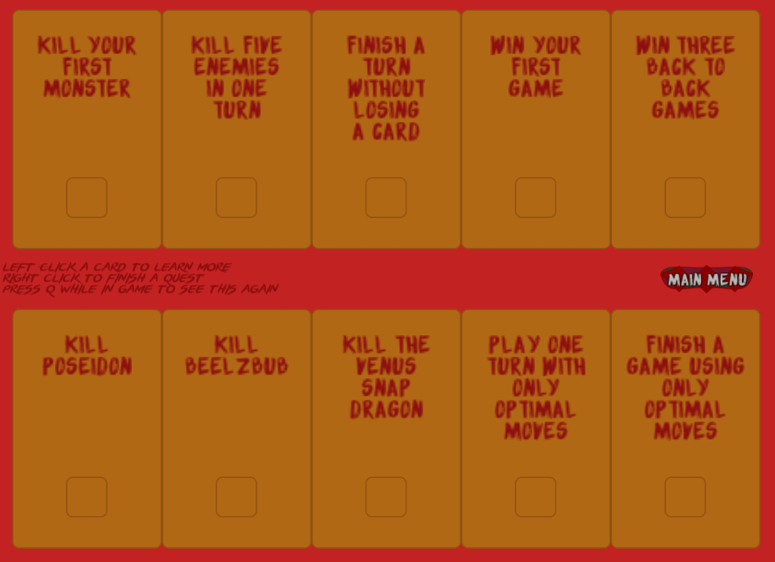
Quests
Ten quest cards
Quest menu accessible from main

Slide 5
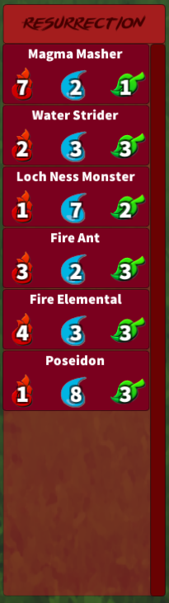
List of selectable items
Resurrection Menu
Every monster that dies is dynamically added
Players can click one per turn to bring it back to life
Adds a new layer of strategy
Need an empty slot, which means sacrificing points
Can replace a terrible monster with an awesome one

Slide 6
Tutorial
12 page tutorial
Shows off each gameplay mechanic
Demonstration of combat scenarios
Prompts users to make a choice and demonstrate
Gives tooltips for each interface element
Toggle-able from main menu
(See demo)

Slide 7
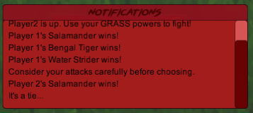
Context sensitive hints
Console window used to display notifications
3 possible hints
30 seconds of inactivity
3 ties in a row
3 card losses in a row
Also displays
Results of each combat
Resurrection
Active player and element

Slide 8
Controls
Use the mouse.
Every action is mouse driven
Scroll on resurrection menu and console
Right-click to “turn-in” quests

Slide 9
Accessibility
Colorblindness
All game information is represented with clearly contrasted numbers
Visually distinctive icons
No information is color-sensitive
Deaf-players
No information is reliant on sound
Sounds are in addition to visual elements
Mostly polish

Slide 10
Changes from Suggestions
Tutorial made more verbose, resets each time it is loaded
Scoring system changed to add deeper strategy and speed up the game
Re-colored most elements to be less abrasive
Pause menu buttons fixed
Resurrection menu implemented
End turn button more clickable
So many bug fixes

